Slide 1

Data Science Project
Supervised by:Dr Sherif ALetreby
T.A: Eng Ahmed Kamal &
Eng Mai

Slide 2
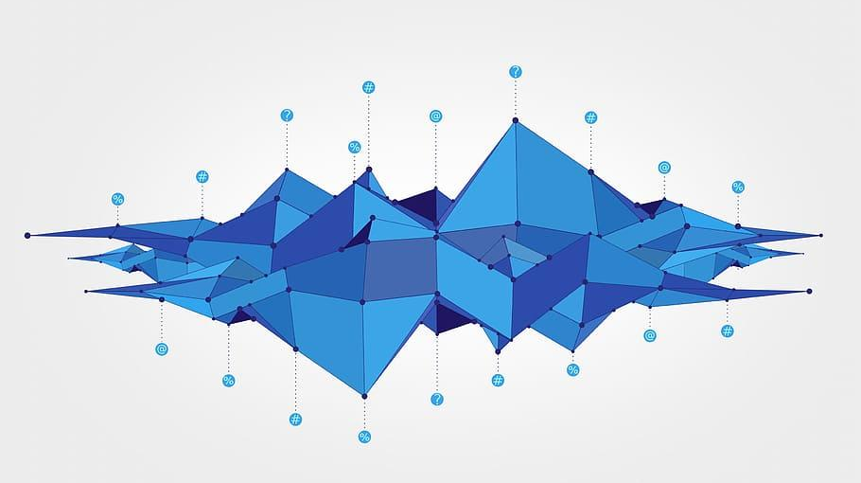
Team Members:
Mohammed Fahd 41820009
Ayman Saad 41910306
Mohamed Bahaa 41810113
Ebrahim hammam 41910296
Omar Ahmed 41910335
Hassan Salem 41910283
Ammar mohammed 41910387

Slide 3

About The Project
Prediction of Garment Employees Data Set we did it using python and analysing dataset
data-driven approach : Classification, Regression
Number of Attributes: 15
Number of Instances: 1197
Project Idea Definition:
The Garment Industry is one of the key examples of the industrial globalization of this modern era. It is a highly labour-intensive industry with lots of manual processes. Satisfying the huge global demand for garment products is mostly dependent on the production and delivery performance of the employees in the garment manufacturing companies. So, it is highly desirable among the decision makers in the garments industry to track, analyse and predict the productivity performance of the working teams in their factories. This dataset can be used for regression purpose by predicting the productivity range (0-1) or for classification purpose by transforming the productivity range (0-1) into different classes.

Slide 4
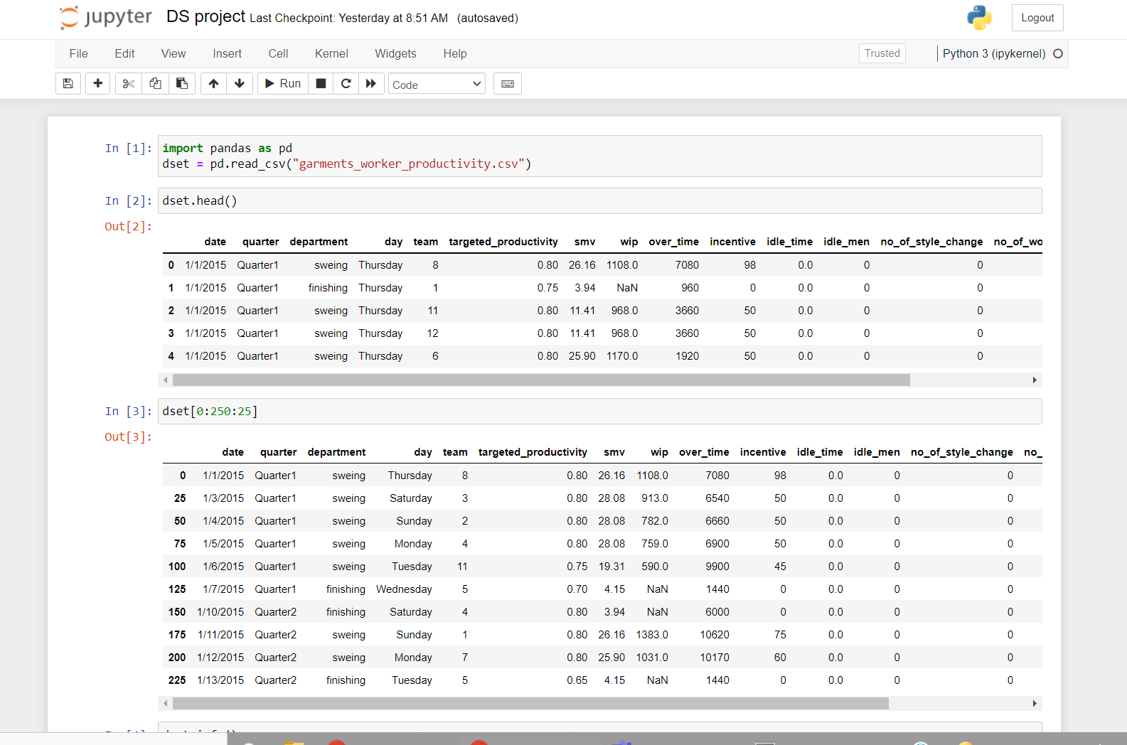
Project Analysis
IN 1
We use pandas lib to read the data
IN 2
to show first 5 records
IN 3
To show random records

Slide 5
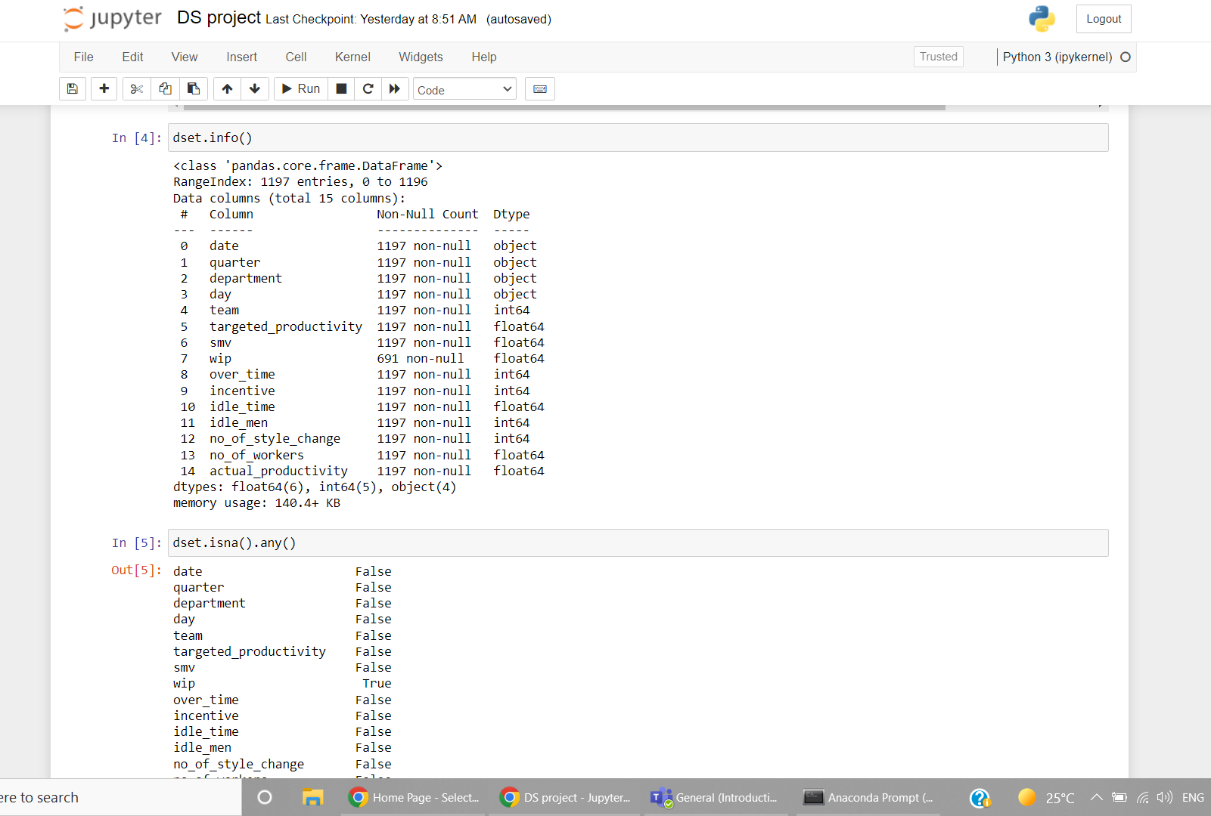
Project Analysis
IN 4
show all dataset information
IN 5
To know if null values
is existing in a column

Slide 6
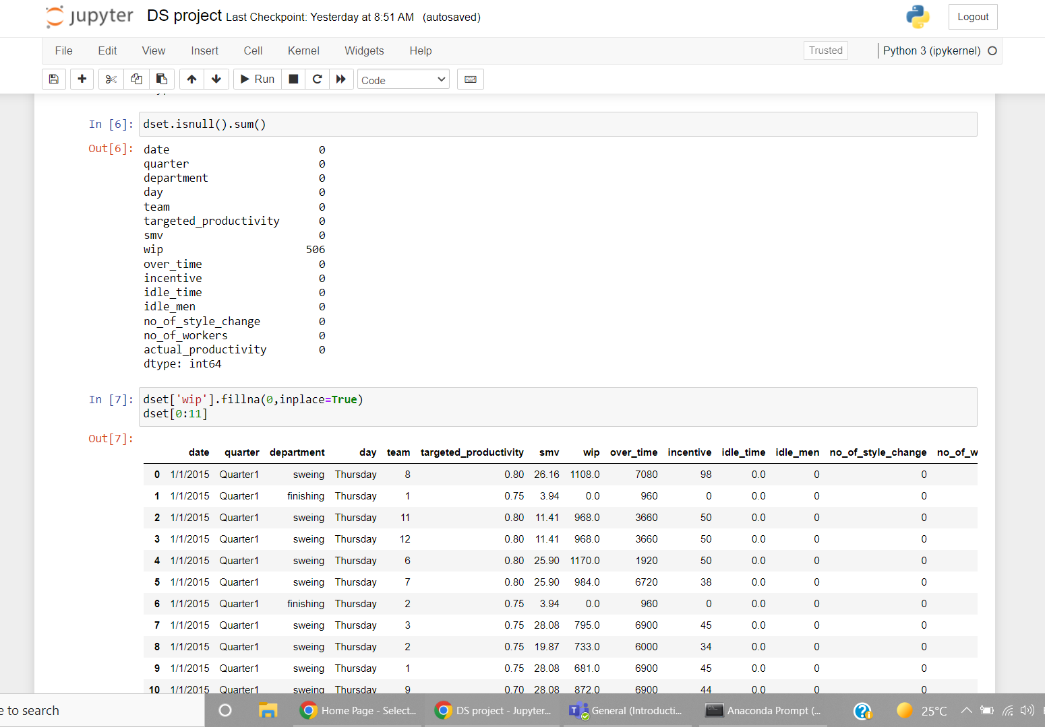
Project Analysis
IN 6
To sum all null values in
each column
IN 7
to fill the null values with zer0s

Slide 7
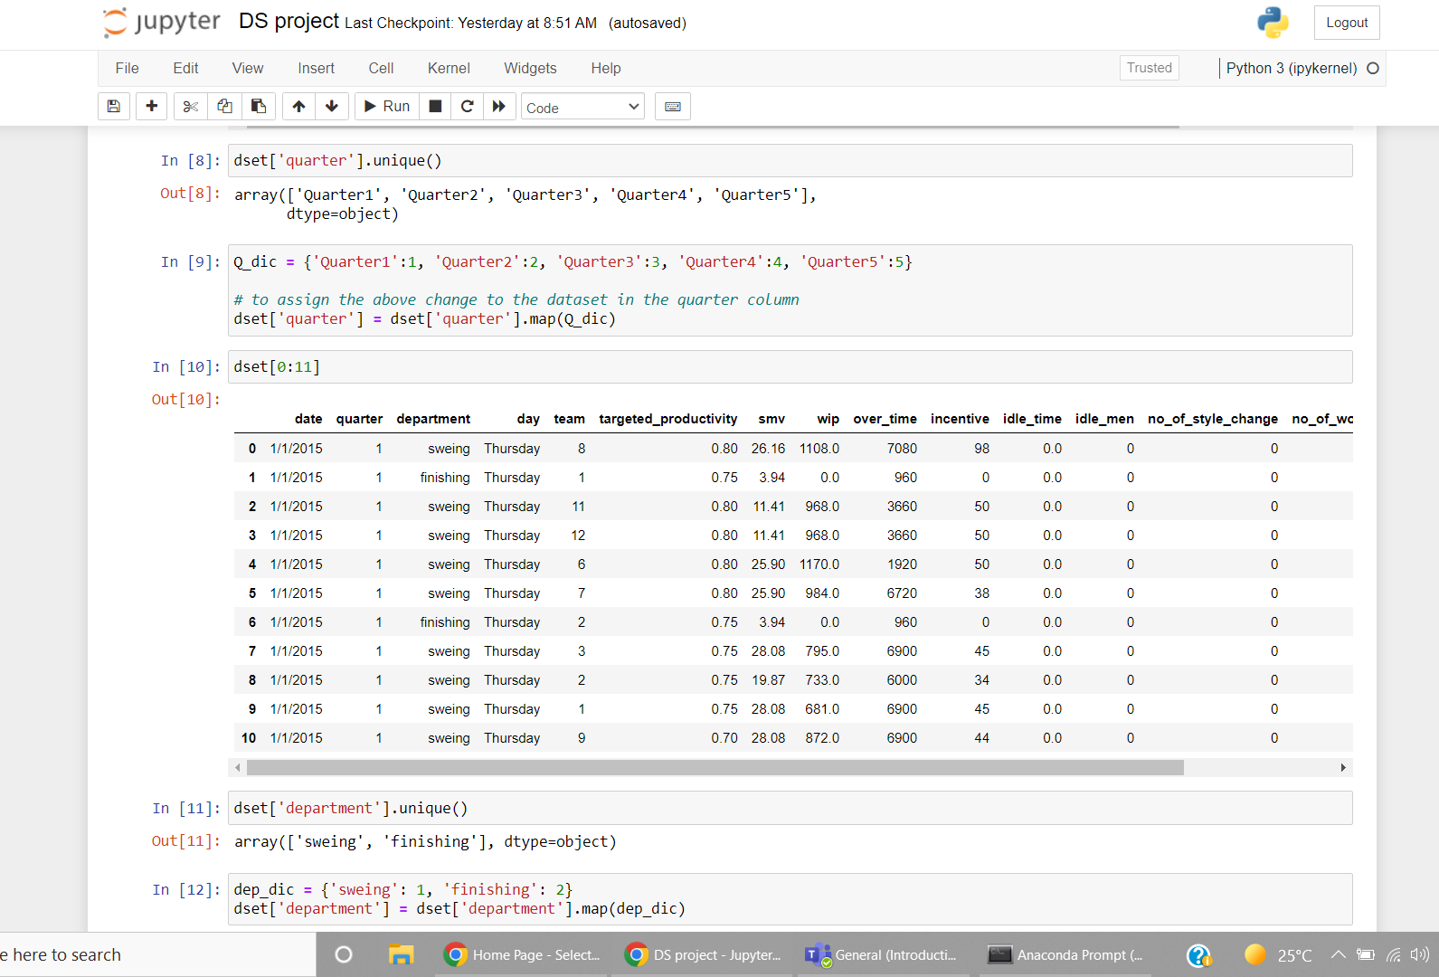
Project Analysis
IN 8
To get all values name in quarter column
IN 9
to label each quarter by a NO.
in order then assign it to the dset
IN 11 & 12
we do the same with the
department column

Slide 8
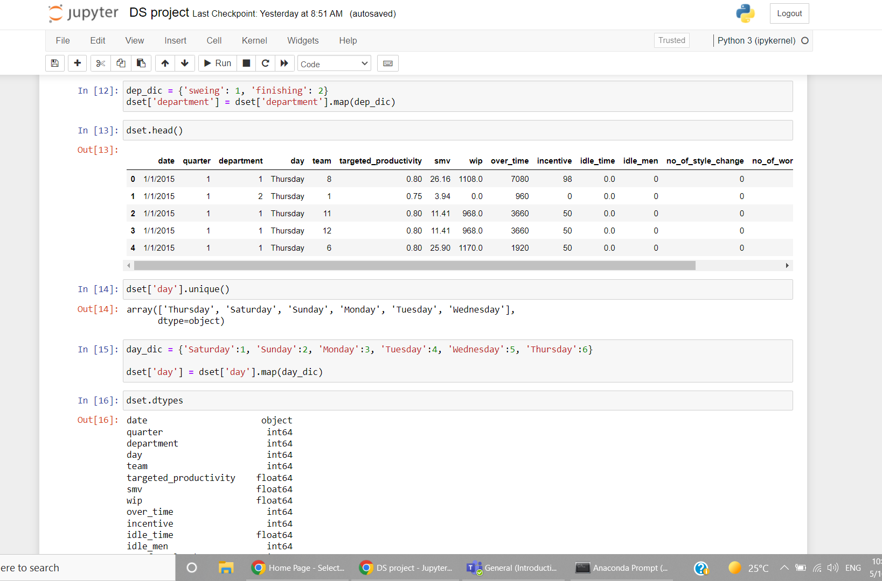
Project Analysis
IN 14 & 15
we do the same with the
days column
IN 16
to check the data types
of each column

Slide 9
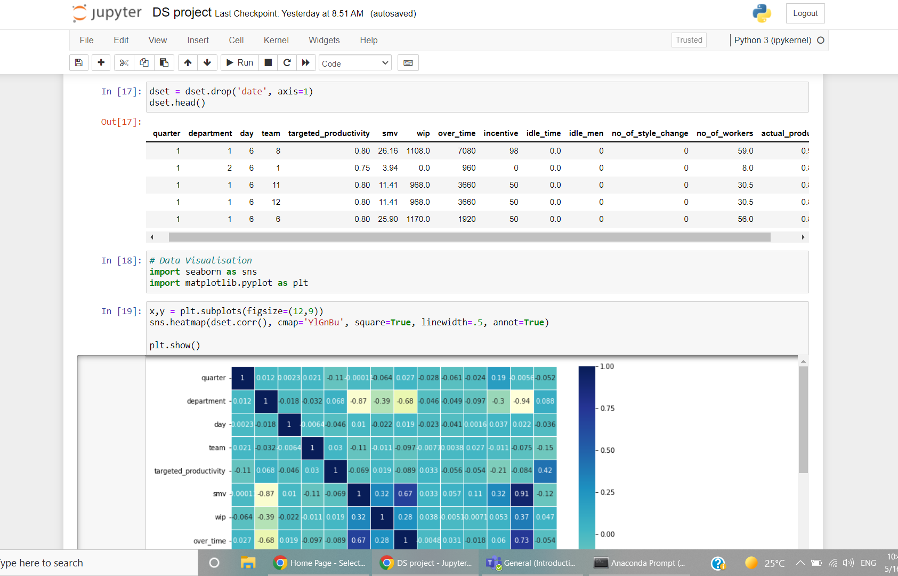
Project Analysis
IN 17
drop the date column
IN 18 & 19
import some libraries for
visualization then plot x and y
and use the heatmap to see the
relations between each feature

Slide 10
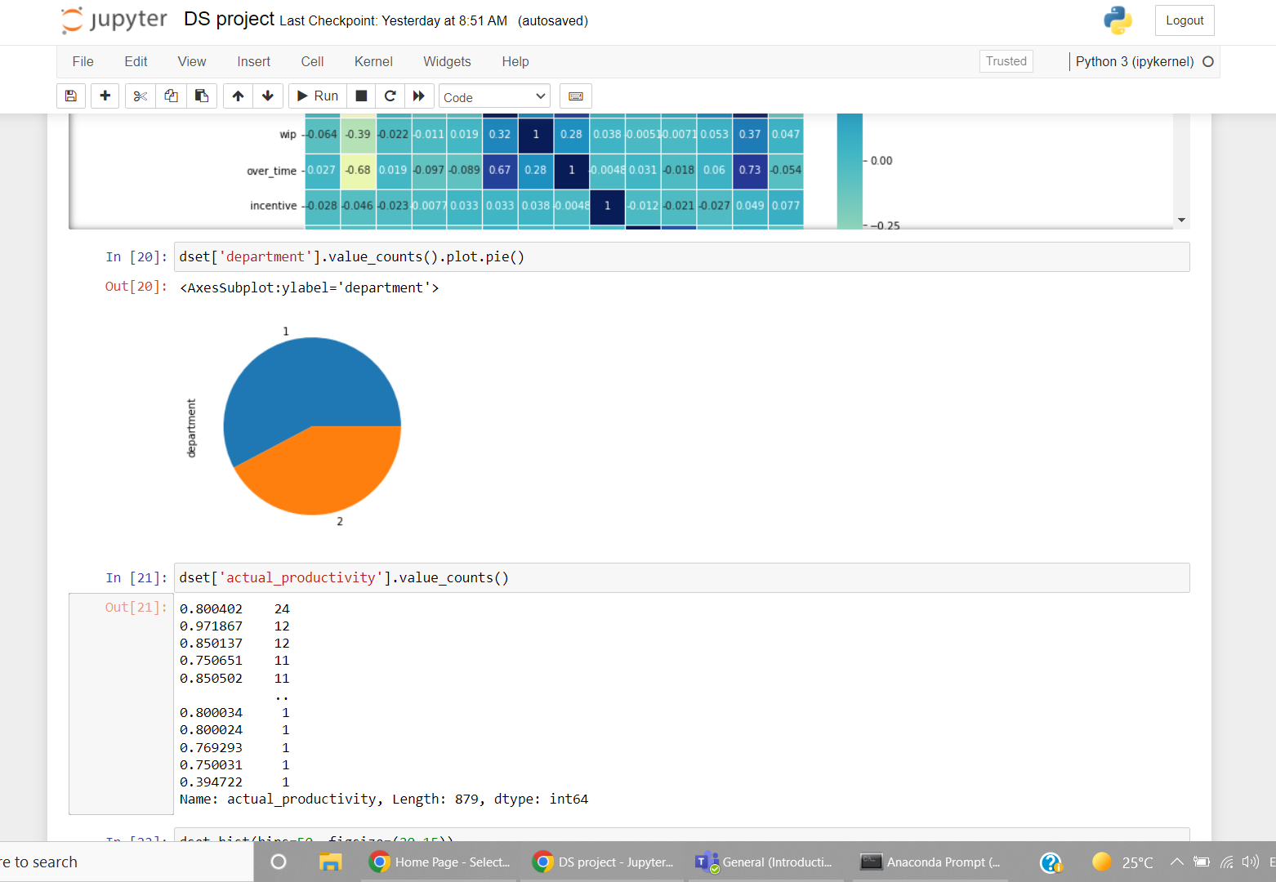
Project Analysis
IN 20
to show pie plot with the values of department col
IN 21
count how many values are
repeated in this column

Slide 11
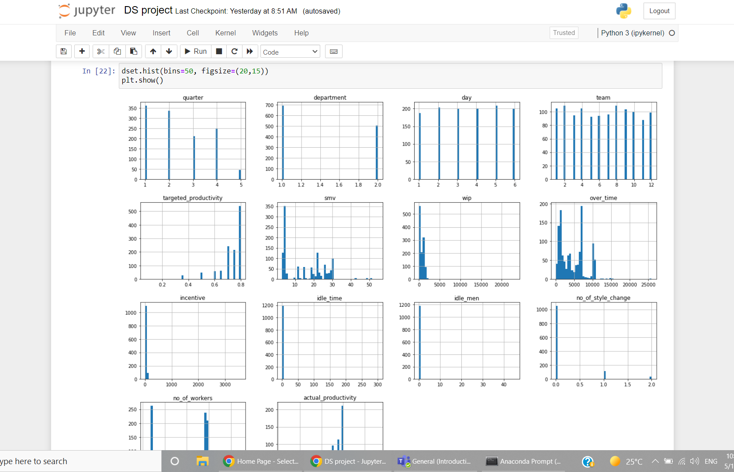
Project Analysis
IN 22
Visualize each feature by histogram to find outliers

Slide 12
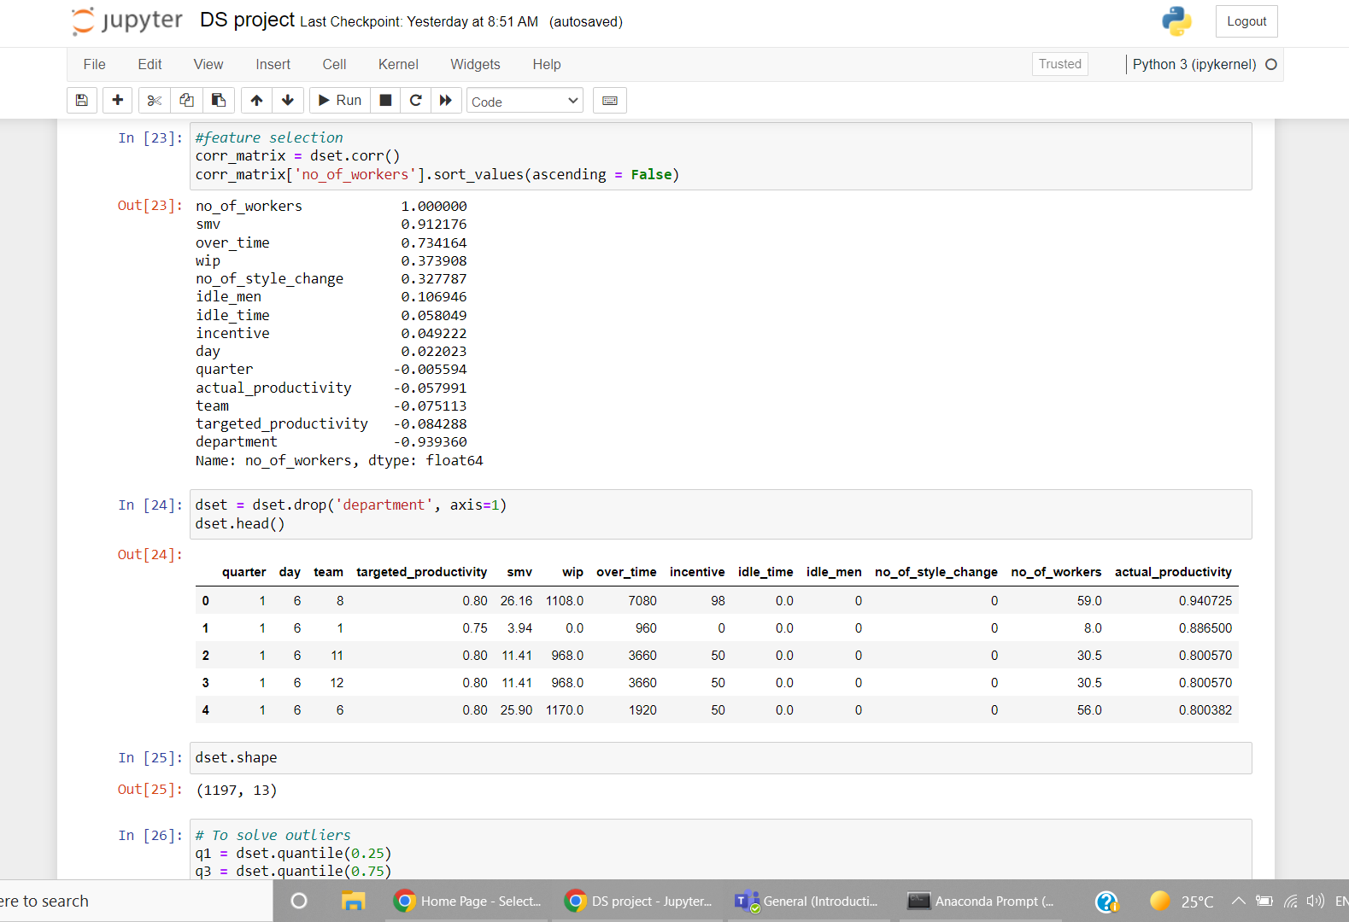
Project Analysis
IN 23
to make correlation matrix starting with No. of workers and descending
IN 24 & 25
drop department because it is low
then show the dimensions

Slide 13
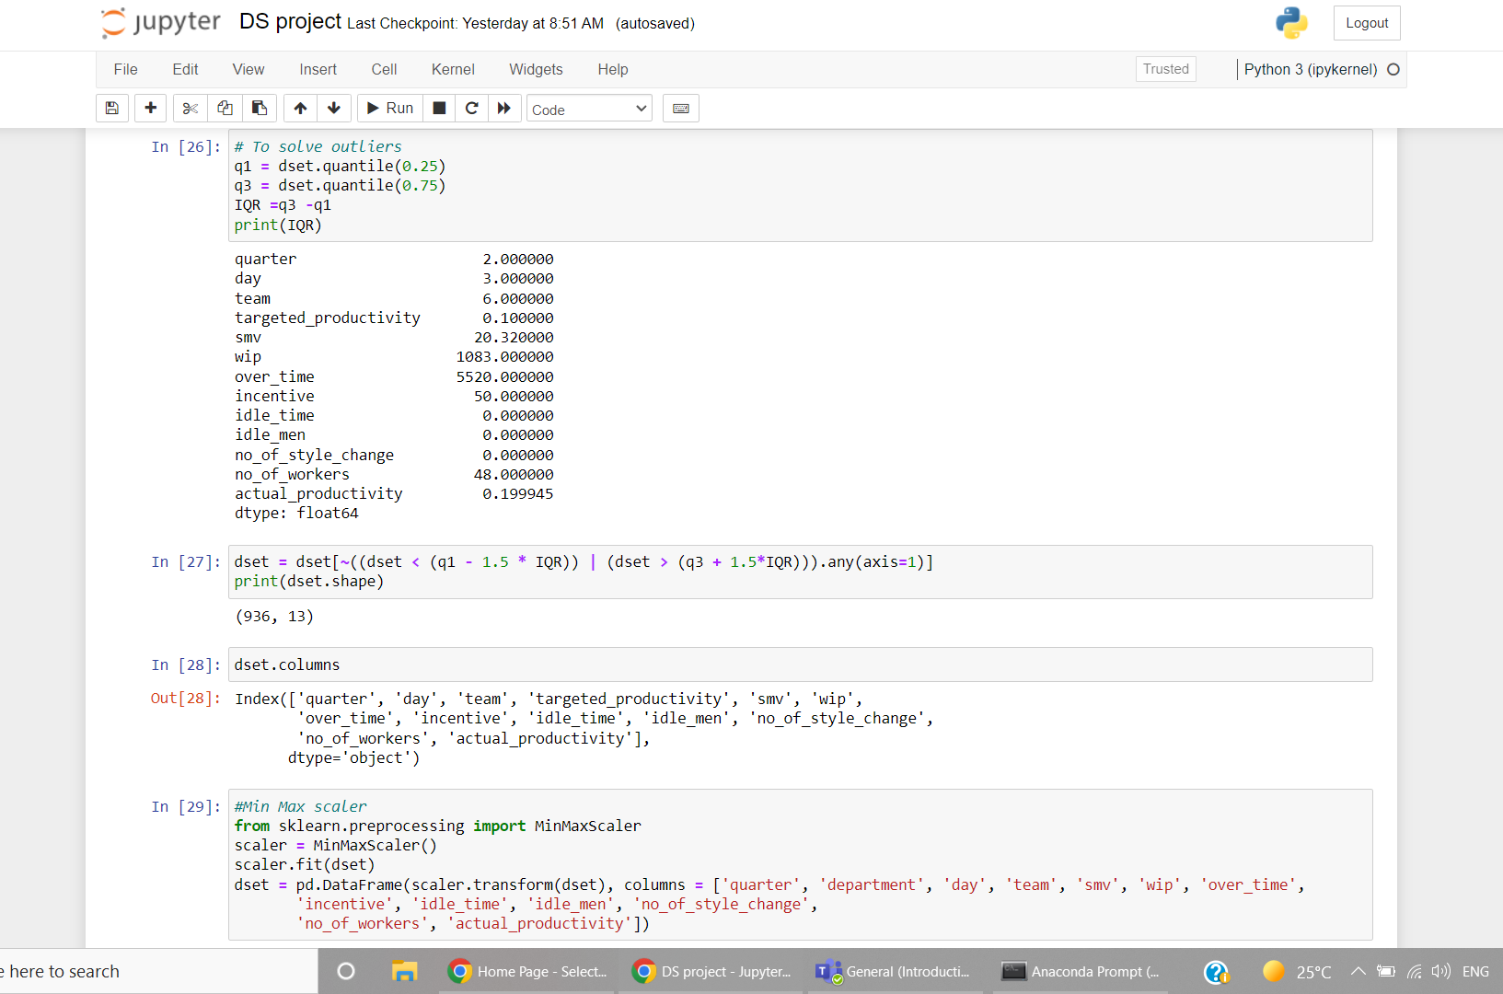
Project Analysis
IN 26
to calculate the IQR and print it
IN 27
To remove the less than Q1 and greater than Q3
IN 29
use min max to normalize the data

Slide 14
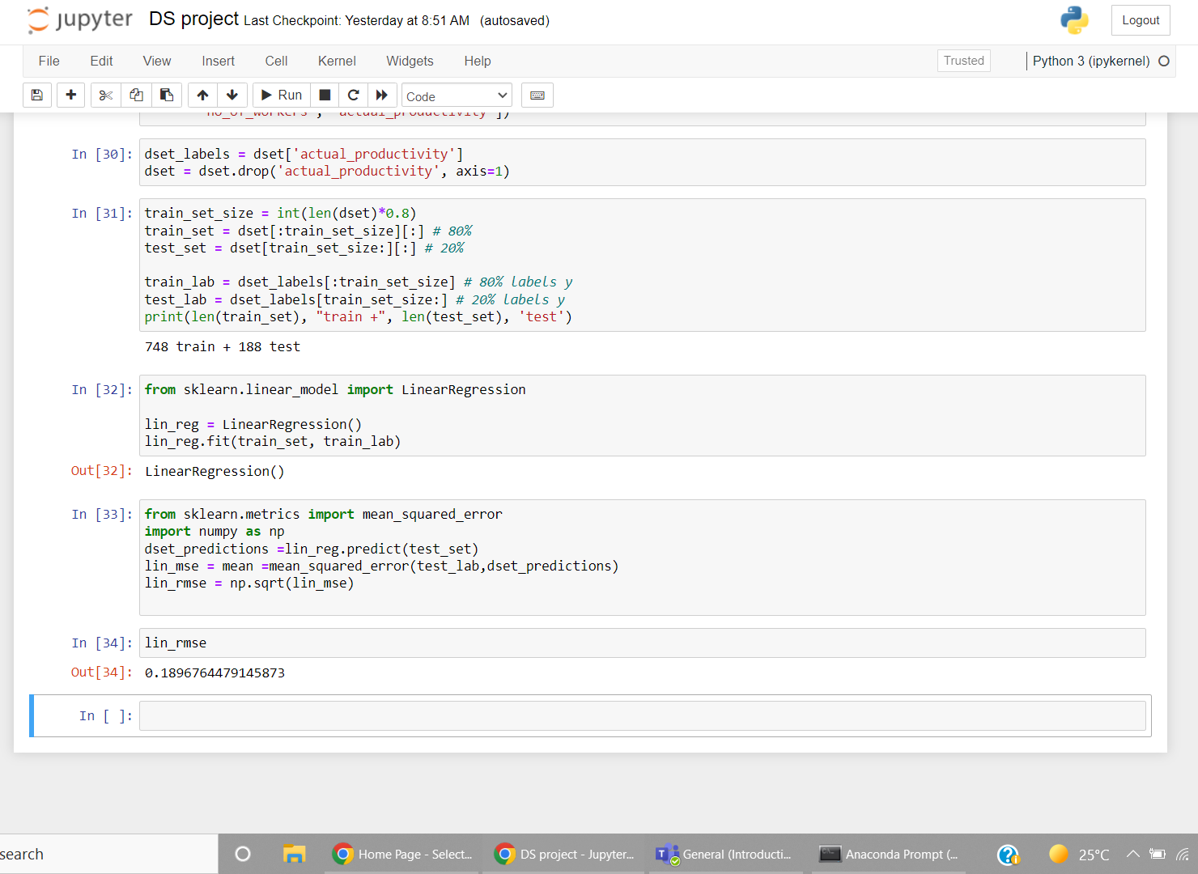
Project Analysis
IN 30
assign the label to var then drop the label column
IN 31
split the data to 80% train and 20% test
IN 32
perform the linear regression algorithm
IN 33
test the data and calculate the mean
square error

Slide 15
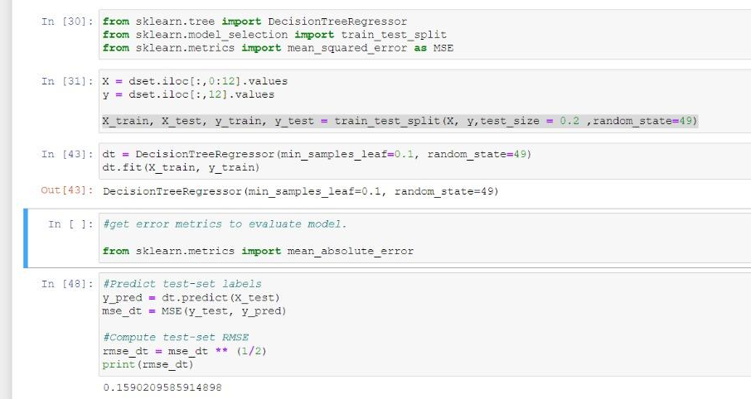
Project Analysis
IN 31
Split the data and
use the function
IN 43
perform the decision
tree algorithm
IN 48
test the data and
calculate the mean
square error & Rmse

Slide 16
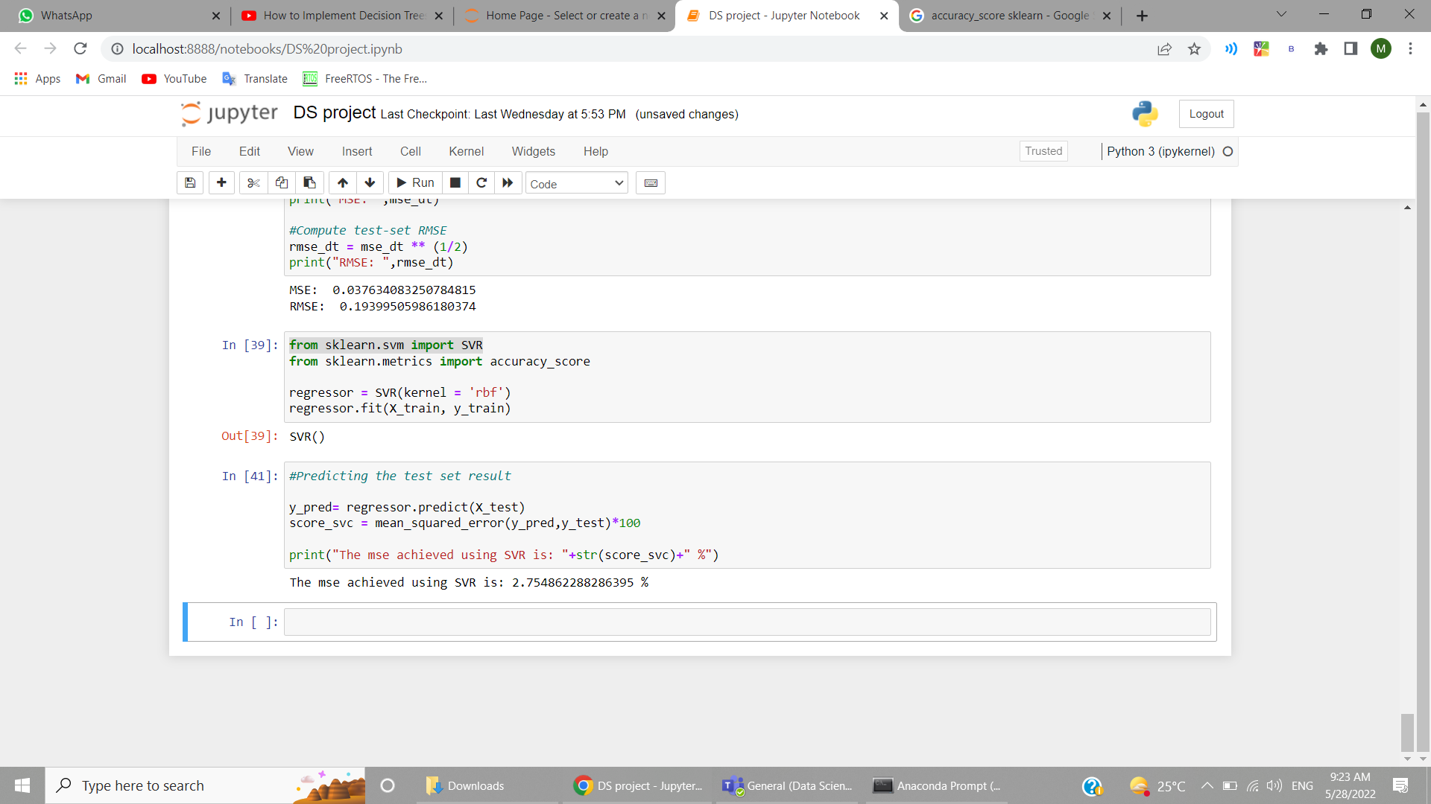
Project Analysis
IN 39
Perform the SVM
algorithm
IN 41
test the data and
calculate the mean
square error

Slide 17
The End

